Slide 1

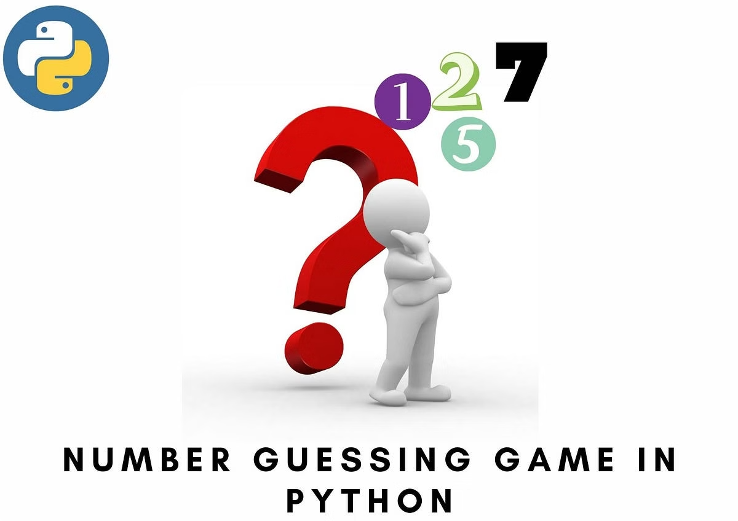
Number Guessing Game
This presentation will guide you through the development of a number guessing game using Python. It will cover the technology used, software requirements, code implementation, and a sample output.

Slide 2
Introduction
The Concept
The Goal
The game challenges the player to guess a randomly generated number within a specific range. The program provides feedback after each guess, indicating whether the guess is too high or too low.
The objective is to create a fun and engaging game where players can test their number-guessing abilities.

Slide 3

Technology Used
1
Python
2
Random Module
Python's simple syntax and extensive libraries make it a perfect choice for game development.
Used to generate a random number for the player to guess.

Slide 4


Software Requirements
Python Interpreter
Text Editor
The core software needed to run Python code.
A tool for writing and editing Python code, such as Notepad++, VS Code, or Sublime Text.

Slide 5





Packages and Methods
random.randint()
input()
Generates a random integer within a specified range.
Takes input from the player (their guess).
print()
Displays text on the screen, including feedback and game instructions.

Slide 6

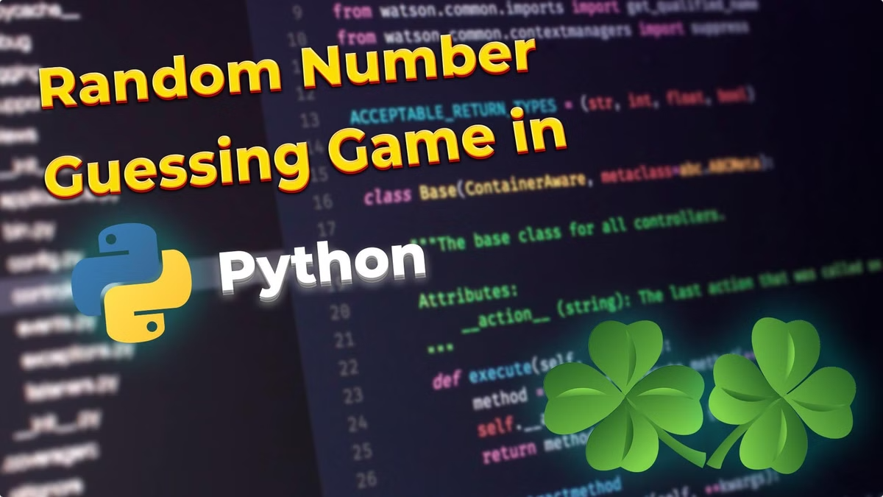
Sample Output
I'm thinking of a number between 1 and 100. Take a guess. Your guess: 50 Too high. Your guess: 25 Too low. Your guess: 37 You got it!

Slide 7
Conclusion
Fun and Engaging
1
The game provides a fun and engaging experience for players of all ages.
Easy to Implement
2
The code is relatively simple and straightforward, making it easy to understand and modify.
Educational
3
The game can help players learn about programming concepts and logical thinking.

Slide 8
Thank You!
Thank you for your time. I hope this presentation has been informative and helpful in understanding how to develop a simple number guessing game using Python.

Slide 9
Team Members
Sandhiya
Rithika
Rakshana
Tejashree
Shamalavalli

